Slide 1
Data Protection for Personalized Health
COM 402
Security and Privacy
Prof. Jean-Pierre Hubaux
Head of LCA1 Lab
Academic Director of the Center for Digital Trust
School of Computer and Communication Sciences
EPFL
With gratitude to the biomedical and CS researchers I have the privilege to work with

Slide 2
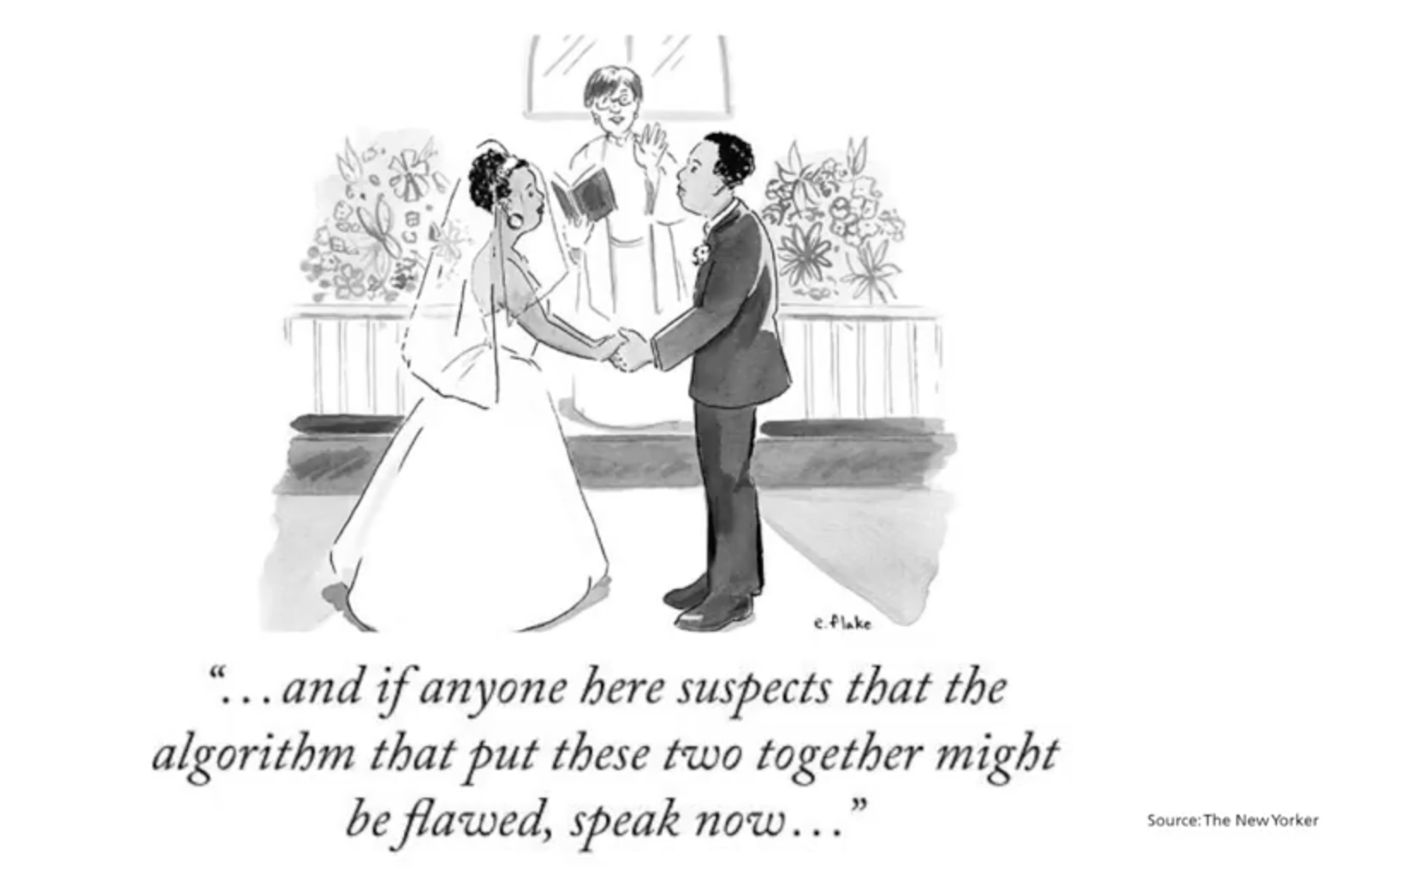

Slide 3
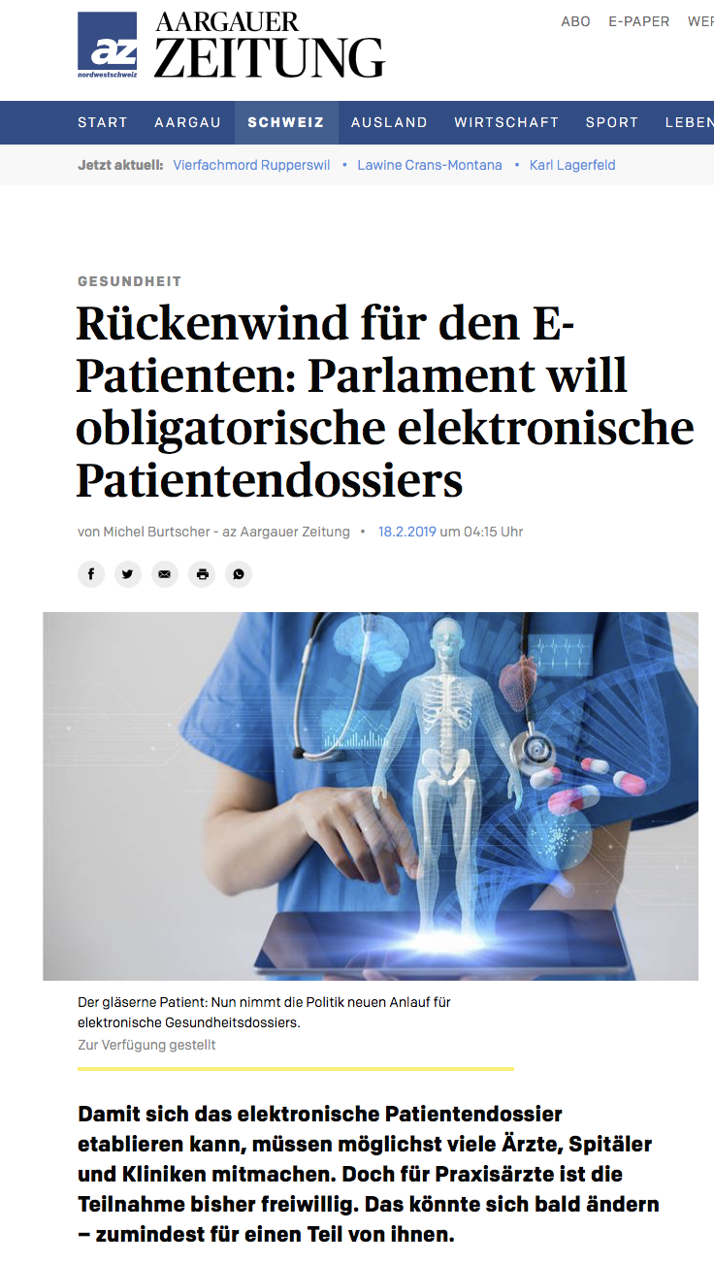
Electronic Health Records are mandated by law in Switzerland
Mandatory for hospitals as of 2020
2 systems will be deployed (by Swisscom and Swiss Post)

Slide 4
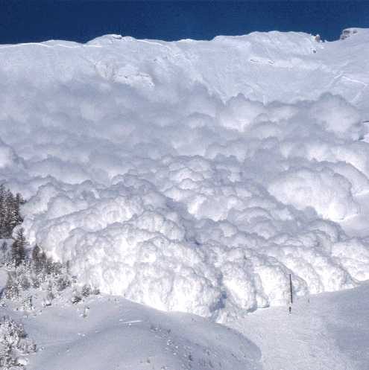
The Genomic Avalanche Is Coming…

Slide 5

Personalized Health
The massive digitalization of clinical and genomic information is providing unprecedented opportunities for improvements in diagnosis, preventive medicine and targeted therapies

Slide 6

Medical Use of Genetics
Genetic disease risk tests help early diagnosis of serious diseases
Pharmacogenomics ➔ personalized medicine

Slide 7
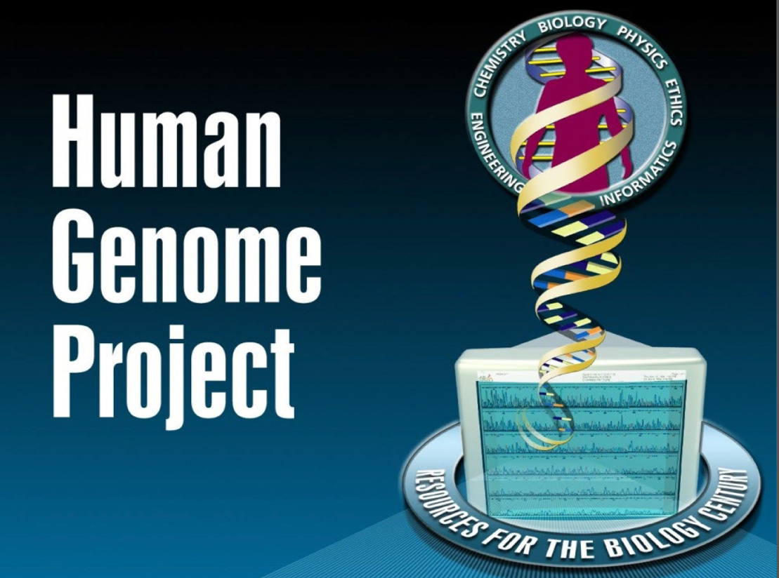
1990 – 2003
Goals
sequencing and identifying all three billion chemical units in the human genetic instruction set,
Finding the genetic roots of disease
Developing treatments
Mostly US/UK effort

Slide 8
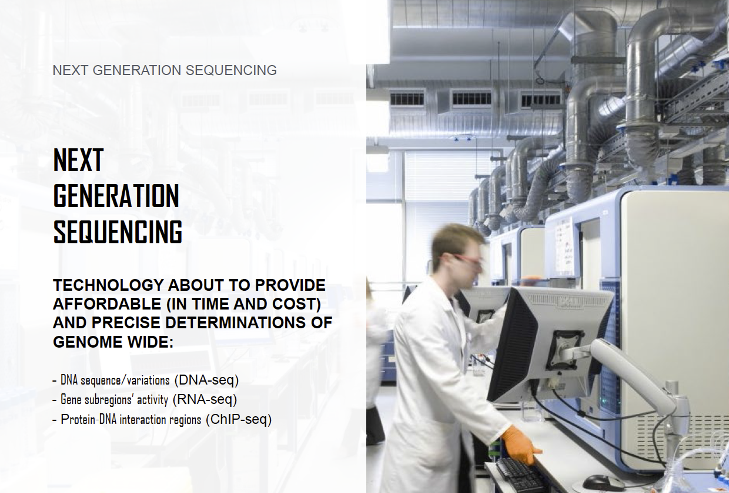

Slide 9
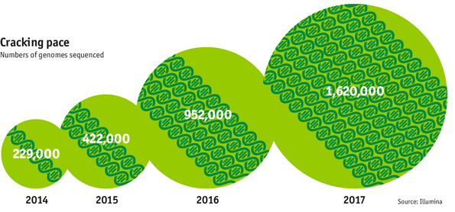
The Genomic Era
Figure from The Economist

Slide 10

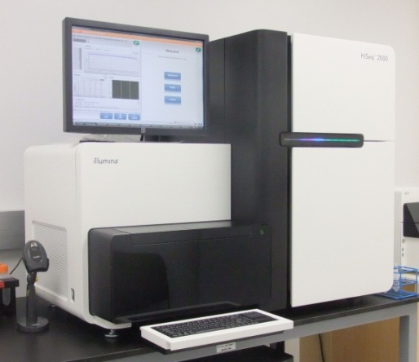

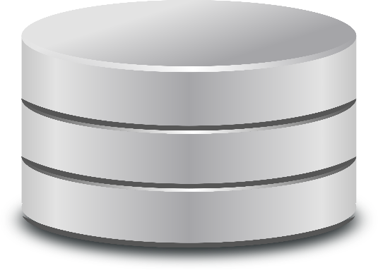

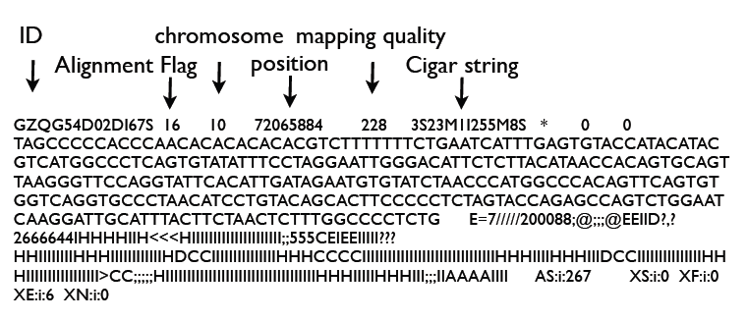
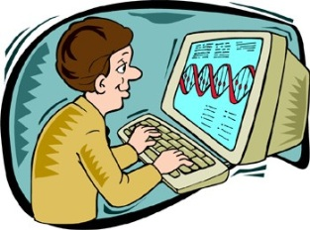
From Blood Sample to Genome Analysis
Raw data
(short reads) FastQ files
Samples
Sequencing machine
Alignment
Variant call
Delta with respect to the reference genome
SAM/BAM file
(aligned reads)
VCF Files
3 billion letter pairs, with high coverage, to take into account:
Sequencing errors
Possible mutations

Slide 11
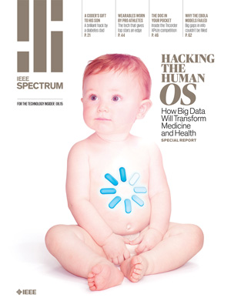

Slide 12
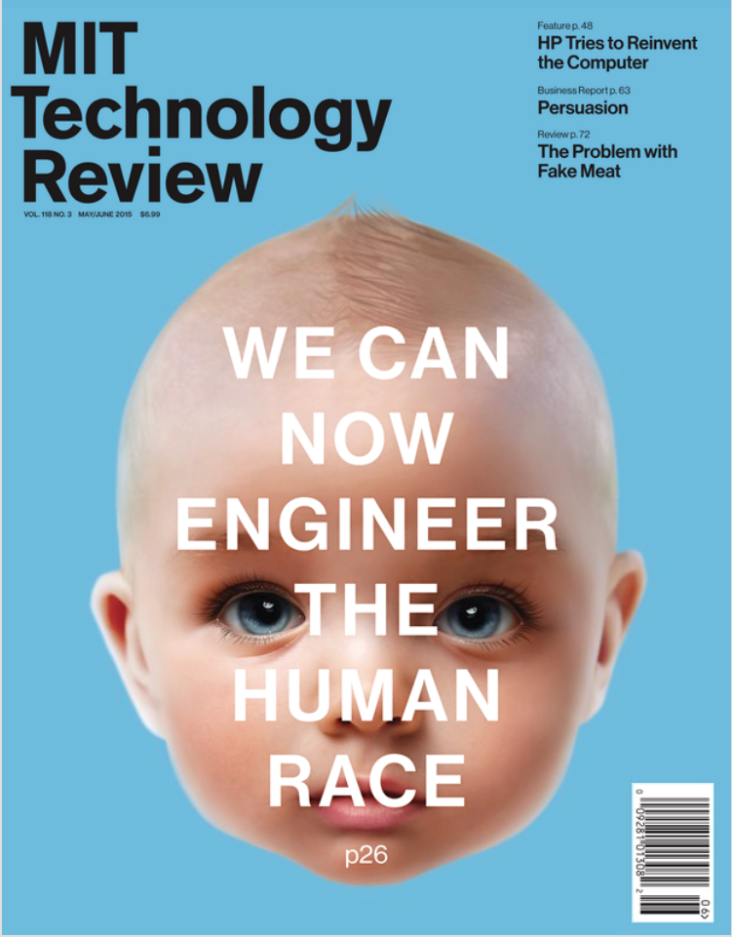

Slide 13
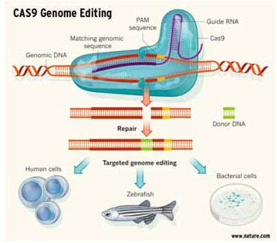
Genome Editing (CRISPR-CAS9)
Potential to alter the human genome
Strong potential for treatment of (human) genetic diseases
Moratorium pronounced in December 2015 for edition of inheritable parts of the human genome
Moratorium not fully respected…
CRISPR: Clustered regularly interspaced short palindromic repeats
CAS9 is a protein

Slide 14
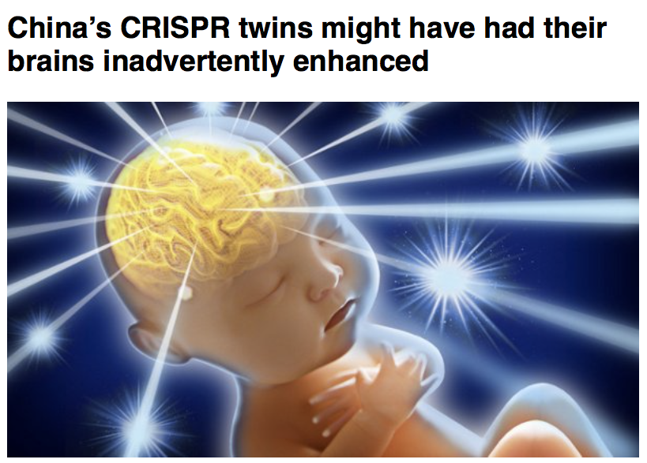
CRISPR: Gene-editing technique
Deletion of gene CCR5 was intended to make babies HIV-resistant
This deletion could increase cognition capabilities

Slide 15
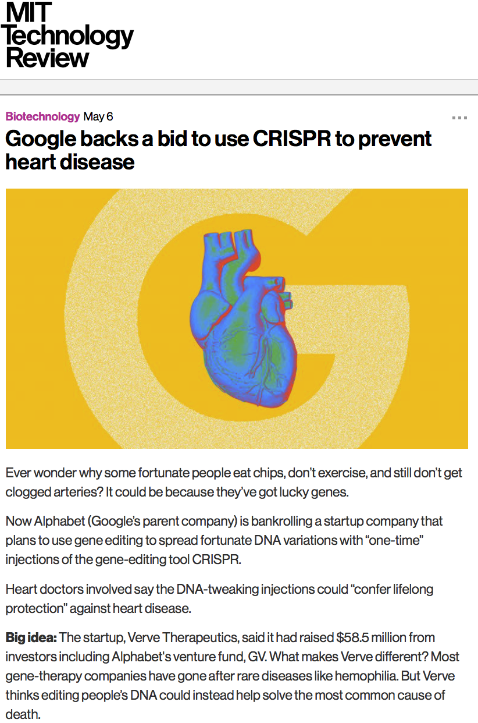
, 2019

Slide 16

Novel, 1931
Movie, 1997

Slide 17
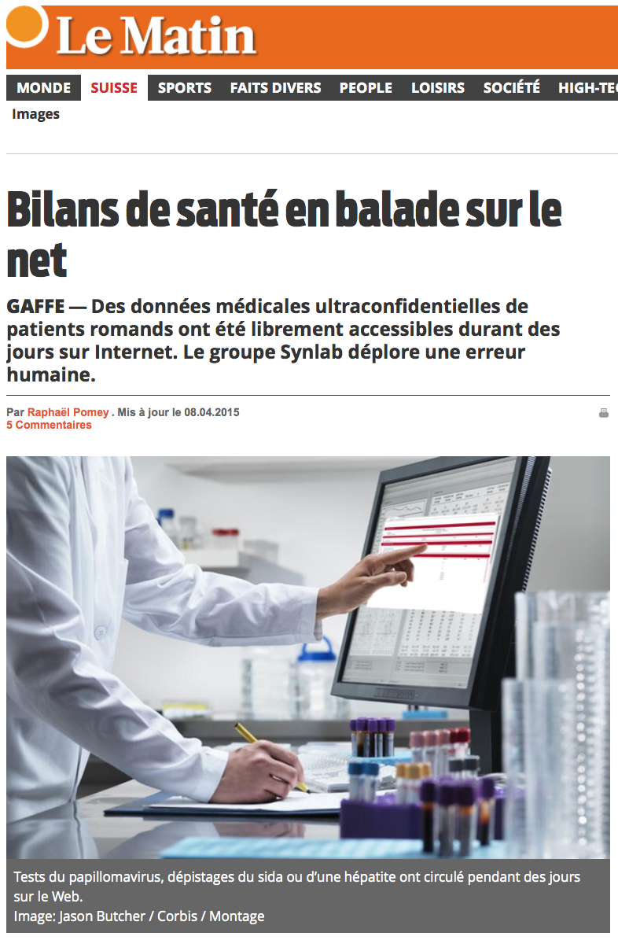
Medical Data Breach in Switzerland
8300 files of medical analyses freely available online, for days
With full patient identifications
Including HIV and other tests
Sheer carelessness (no attack)
(April 2015)

Slide 18
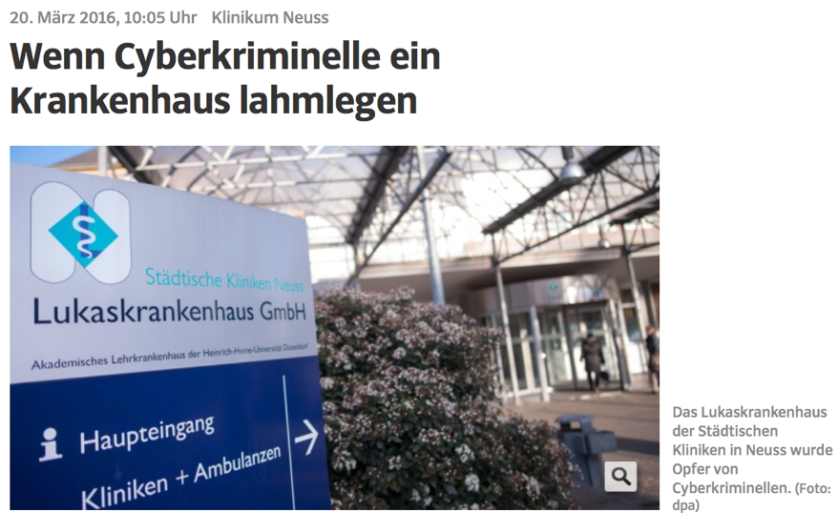
Ransomware Attack against German Hospitals

Slide 19
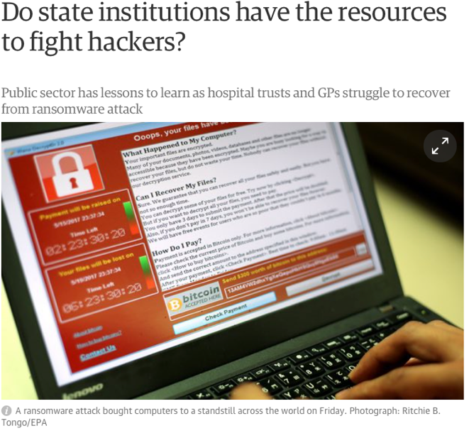
“WannaCry” Ransomware Virus (May 2017)
The Guardian,
14 May 2017

Slide 20
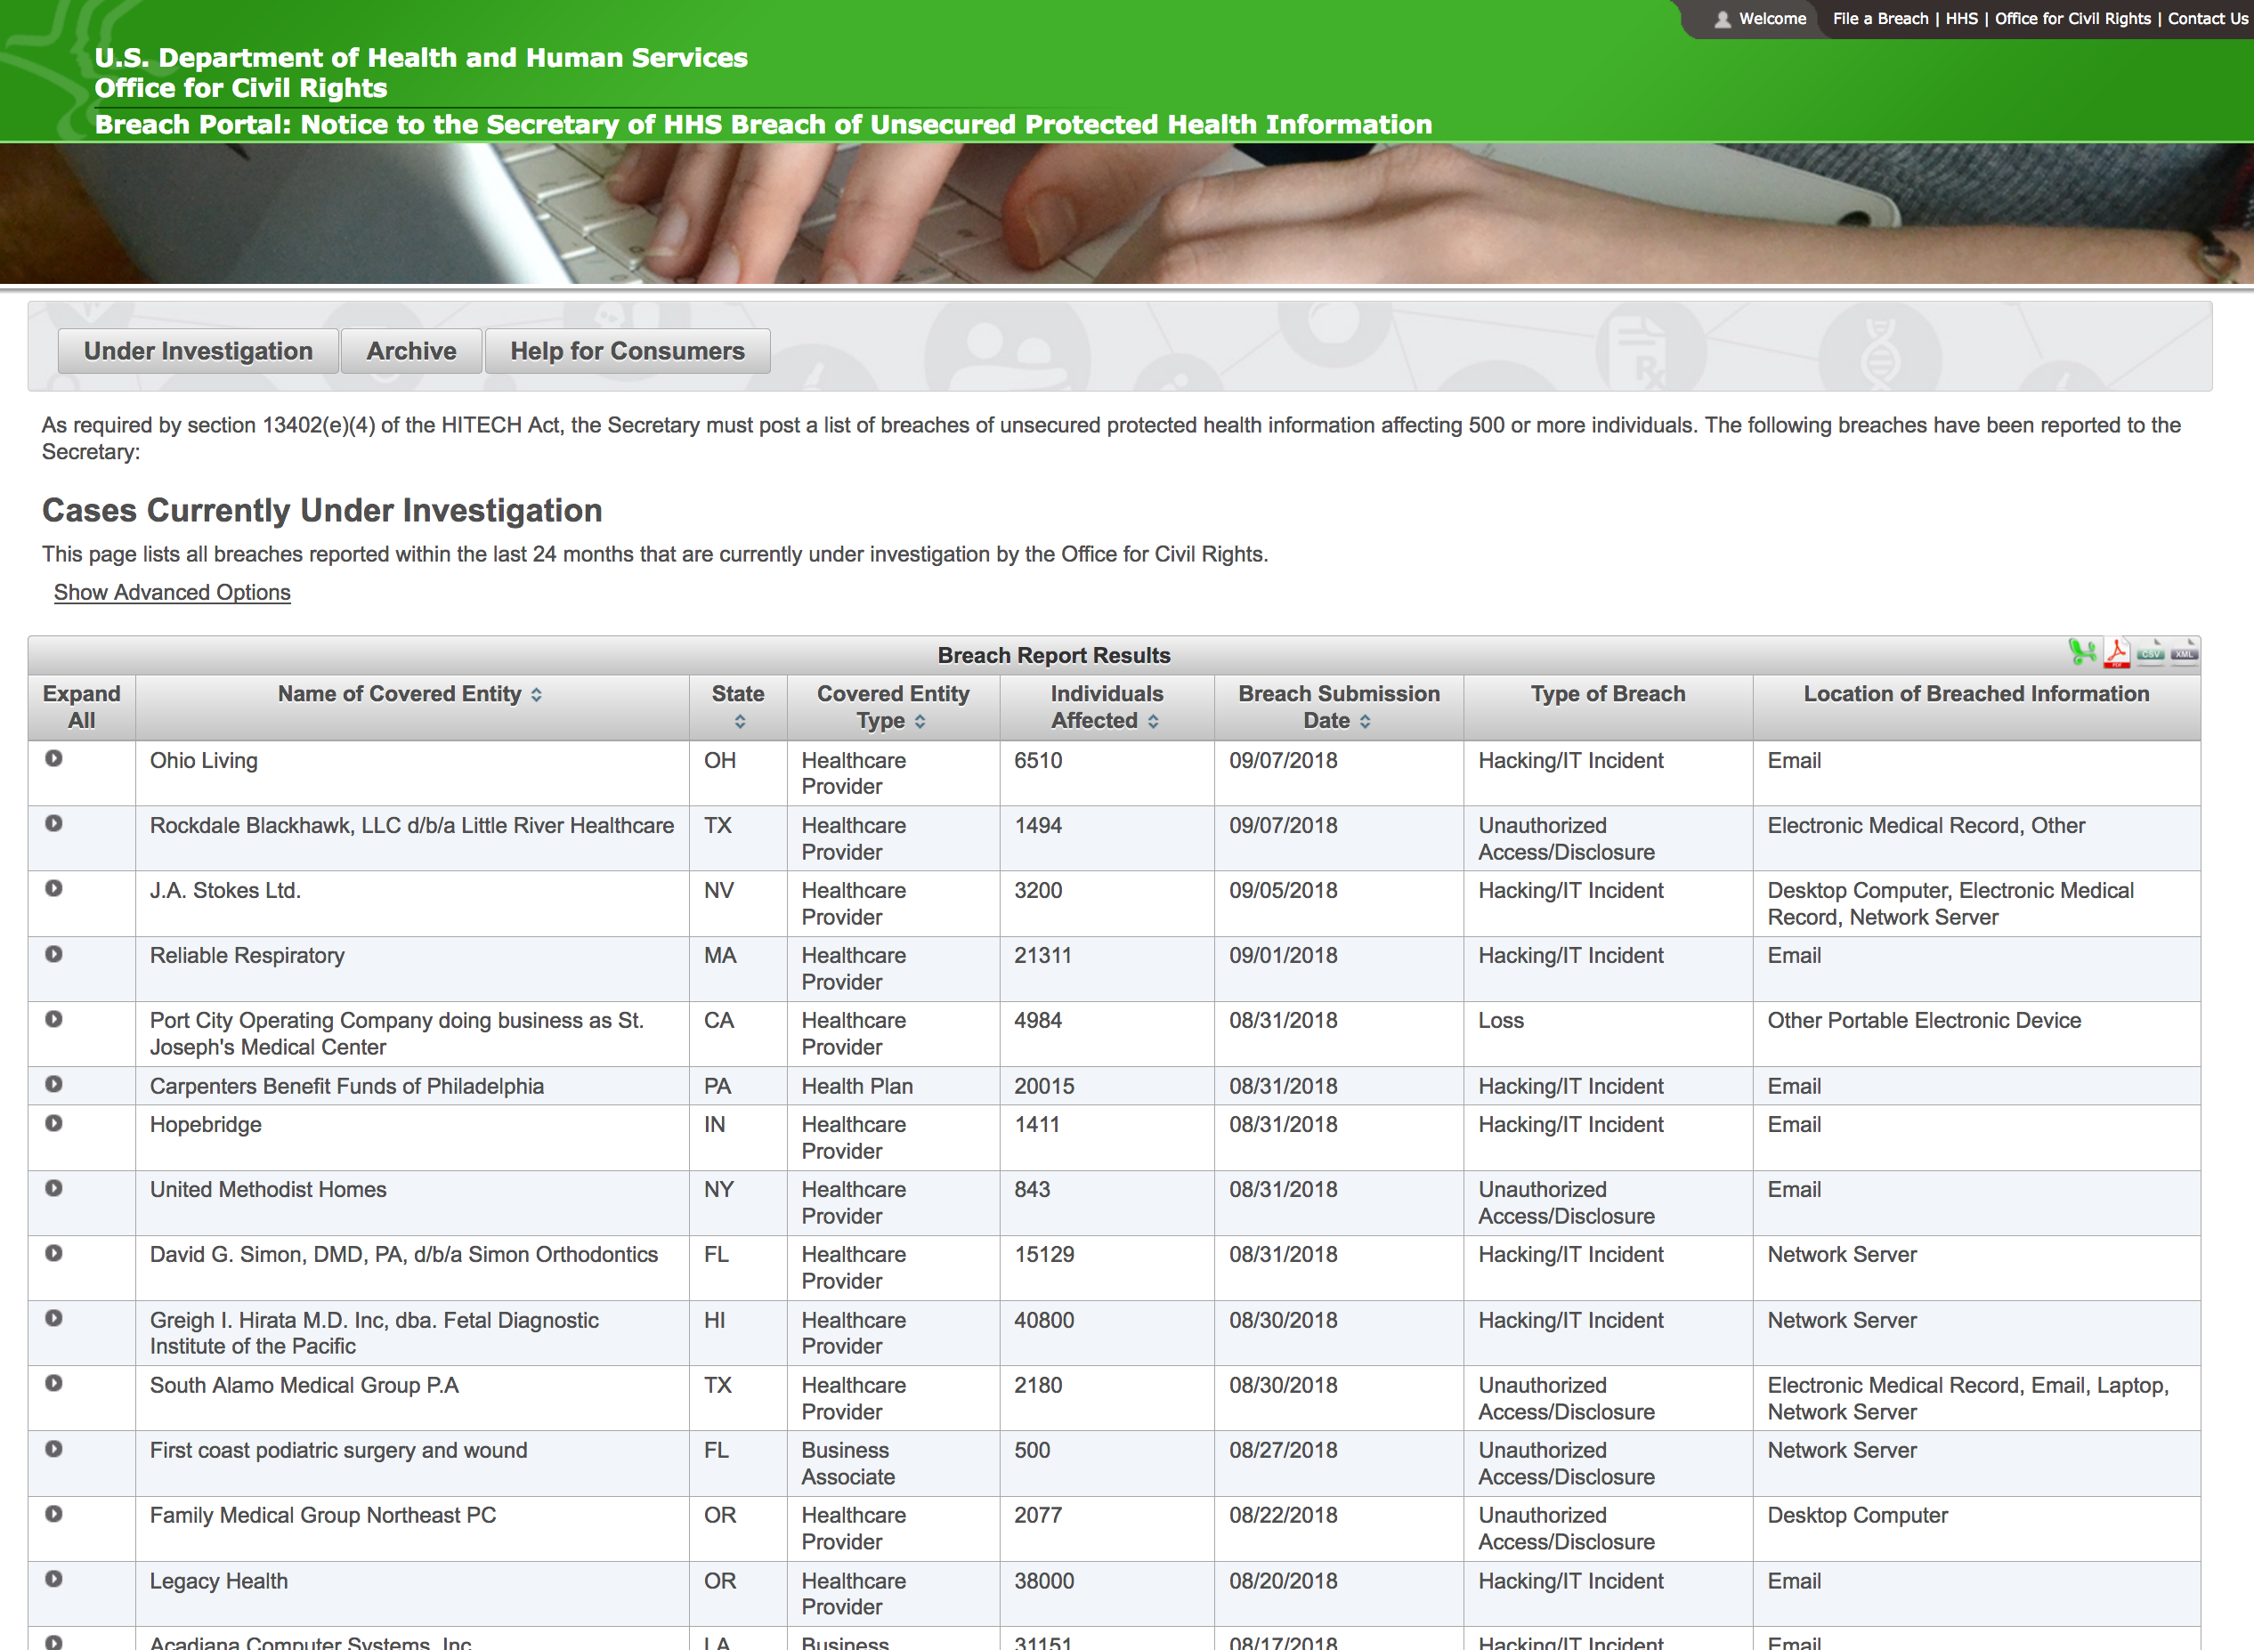
US Healthcare Official “Wall of Shame”
https://ocrportal.hhs.gov/ocr/breach/breach_report.jsf
Around 5 declared breaches per week, each affecting 500+ people

Slide 21

Hospital / pharma interface
$
De-identifica- tion process
De-identified data
Patient data
Pharma company

Slide 22
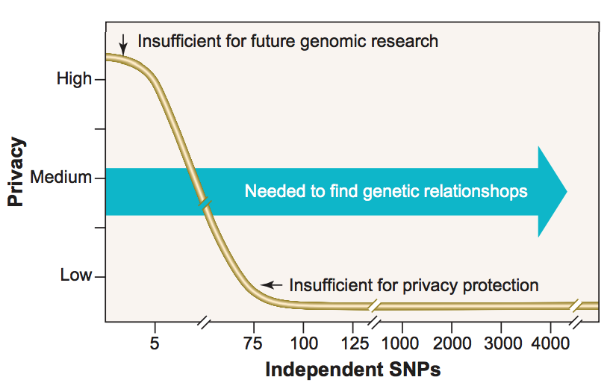
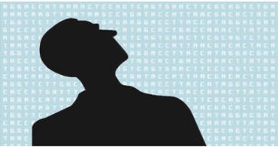
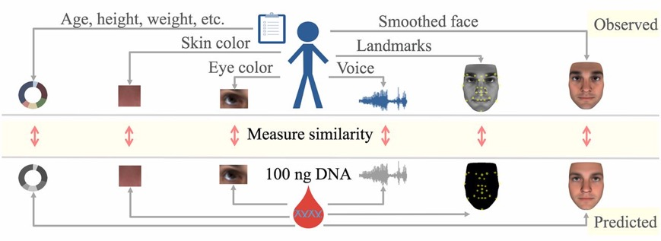
De-identification of genomic data is impossible
Lin et al. 2004 Science: 75 or more SNPs (Single Nucleotide Polymorphisms) are sufficient to identify a single person
Homer et al. 2008 PLOS Genetics: aggregated genomic data (i.e., allele frequencies) can be used for re-identifying an individual in a case group with a certain disease
Gymrek et al. 2013 Science: surnames can be recovered from personal genomes, linking “anonymous” genomes and public genetic genealogy databases
Lipper et al. 2017 PNAS: Anonymous genomes can also be identified by inferring physical traits and demographic information
Many more to come…
Notes:
Standard de-identification and anonymization techniques (data suppression, swapping, obfuscation) are ineffective with genomic data

Slide 23
Most common genetic variation: Single Nucleotide Polymorphism (SNP)
Occurs when, at a specific position, at least a single nucleotide (A,C,G, or T) differs between members of the same species in more than 1% of the population
Potential nucleotides for a SNP are called alleles
2 different alleles can be observed for each SNP:
Major allele (M)
Minor allele (m)
Every genome carries 2 alleles at each SNP position A SNP can be either:
Homozygous minor [m,m]
Heterozygous [m,M] or [M,m]
Homozygous major [M,M]
Individual A
. . .
A | A | G | G | C | C | A | A | C
. . .
A | T | G | G | C | C | A | A | C
Individual B
A | T | G | G | C | C | A | G | C
. . .
. . .
A | T | G | G | C | C | A | G | C
SNP position 2
Alleles: A,T
Major: A
Minor: T
SNP position 8
Alleles: A,G
Major: G
Minor: A

Slide 24
Alice and Bob: The Long Awaited Happy End
After having extensively authenticated each other,
after having exchanged thousands of highly private messages,
after having established numerous secure channels between each other,
after years of intense but platonic relationship, finally, finally…❤️

Slide 25


… Alice and Bob got closer to each other
Alice
Bob
. . .
A | T | T | G | C | C | G | A | C
. . .
. . .
A | A | T | G | T | C | G | T | C
. . .
C | T | G | G | T | C | A | A | T
C | T | T | G | C | C | A | A | C
Gamete
Production
(spermatozoon)
Gamete
Production
(ovule)
A | T | G | G | C | C | G | A | C
A | A | T | G | C | C | A | T | C
A | A | T | G | C | C | A | T | C
A | T | G | G | C | C | A | A | C
Child

Slide 26
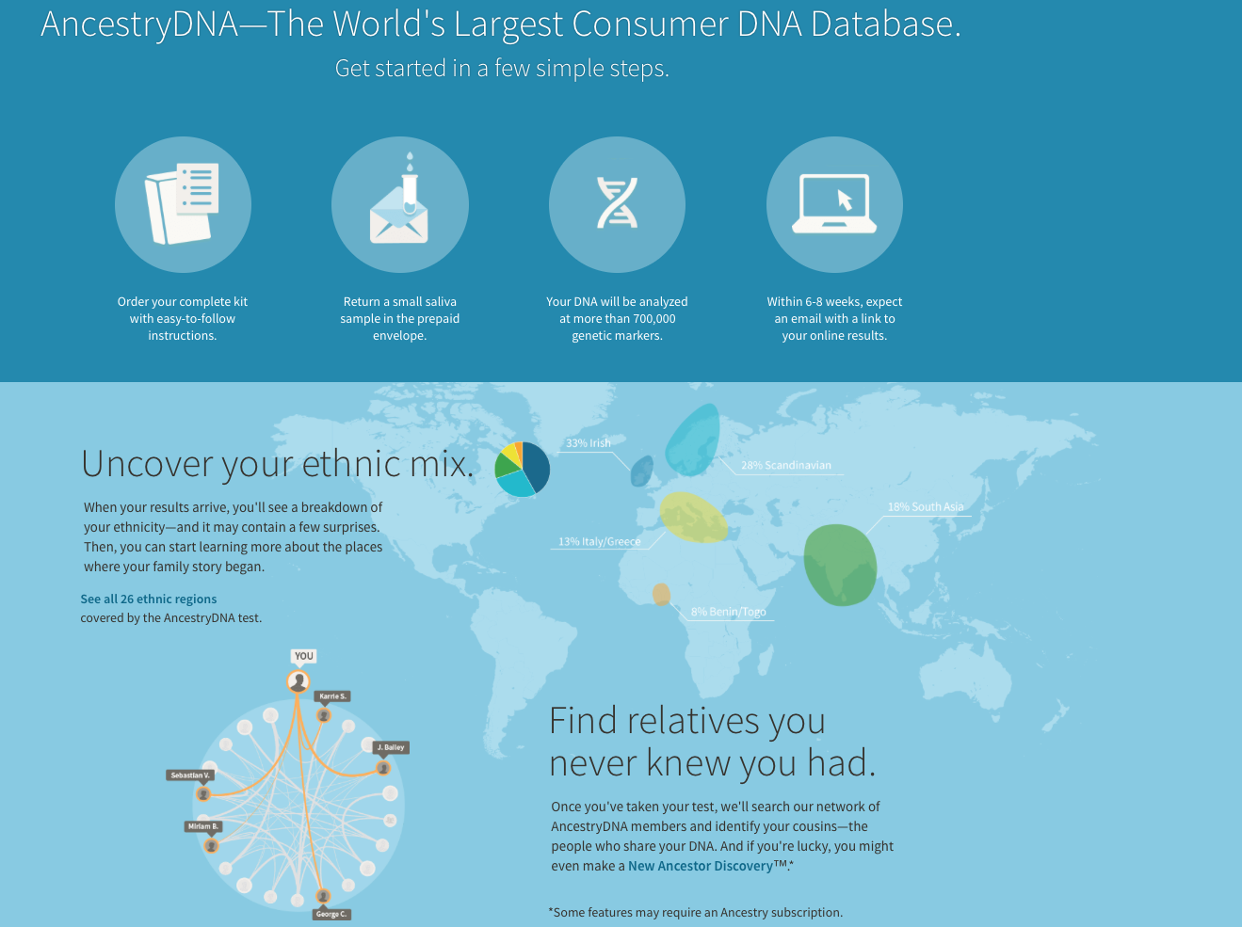
Direct to Consumer Genomics (1/2)
Ancestry.com (millions of customers)

Slide 27
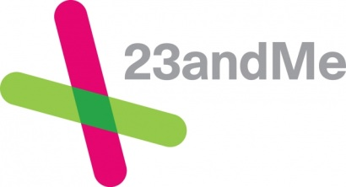
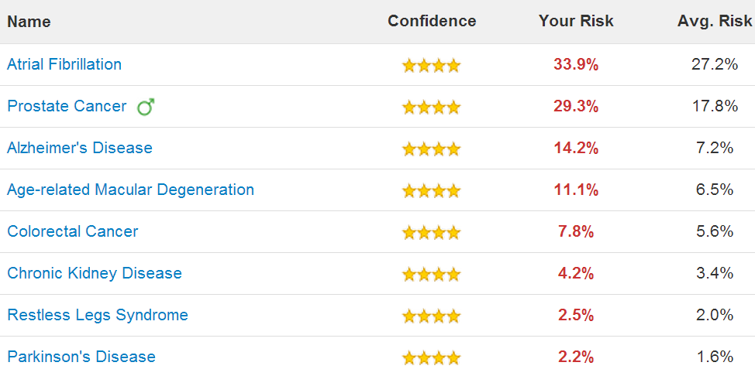
Direct to Consumer Genomics (2/2)
23andMe.com (millions customers)

Slide 28
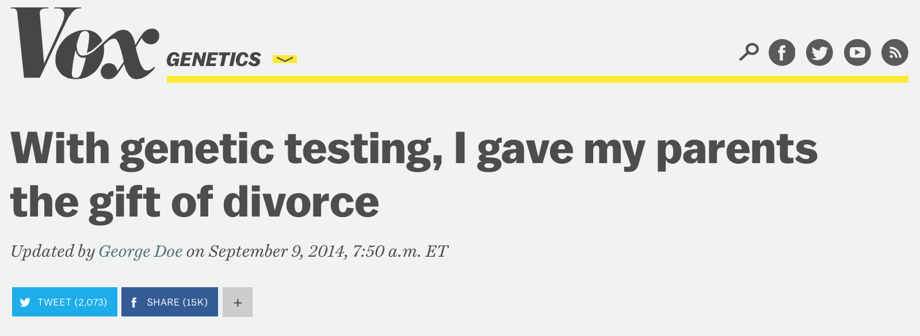

Slide 29
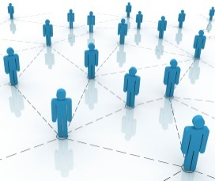

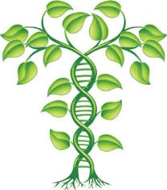


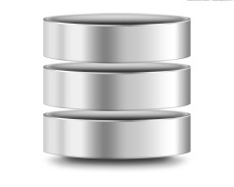

Online Social Networks
Facebook
Google+
Twitter
Linkedin
Ancestry Search and
Family History Resources
Health and Genome Websites
Ancestry.com
FamilyTreeDNA.com
Ysearch.org
Geni.com
OpenSNP.org
Patientslikeme.org
CureTogether.com
23andMe.com
Public Records
Research Datasets
Census records
Marriage records
Obituaries
Criminal records
Court dockets
Voter registrations
1000 Genomes Project
HapMap Project
dbGaP
Personal Genome Project
UK 100K Genome Project
De-identification
Kinship inference
Genetic discrimination
Blackmail

Slide 30
Re-identification attacks on genomic data have a long history
10,000 – 50,000 SNPs are sufficient to determine if an individual was part of a cohort, even when he contributed < 0.1% of the data
Many other subsequent studies extended the range of vulnerabilities for summary statistics:
[Jacobs et al. Nature Genet. ‘09], [Vissecher and Hill PLoS Genet. ‘09], [Sankararaman et al. Nature Genet. ‘09], [Wang et al. CCS’09], [Clayton Biostatistics ’10], [Im et al. Am. J. Hum. Genet. ‘12], …
Notes:
[1] Homer N, Szelinger S, Redman M, Duggan D, Tembe W, et al. (2008) Resolving Individuals Contributing Trace Amounts of DNA to Highly Complex Mixtures Using High-Density SNP Genotyping Microarrays. PLoS Genet 4(8): e1000167. doi:10.1371/journal.pgen.1000167

Slide 31
Homer’s Attack
Adversary has access to a known participant’s genome
Goal: determine if the target individual is in the case group
Uses simple correlation in the genome (linkage disequilibrium)
Attack later improved by Wang et al.
N. Homer, S. Szelinger, M. Redman, D. Duggan, and W. Tembe. Resolving individuals contributing trace amounts of DNA to highly complex mixtures using high-density SNP genotyping microarrays. PLoS Genetics, 4, Aug. 2008.

Slide 32
Homer’s Attack
Figure from: Wang et al. Learning Your Identity and Disease from Research Papers: Information Leaks in Genome-Wide Association Study
N. Homer, S. Szelinger, M. Redman, D. Duggan, and W. Tembe. Resolving individuals contributing trace amounts of DNA to highly complex mixtures using high-density SNP genotyping microarrays. PLoS Genetics, 4, Aug. 2008.

Slide 33
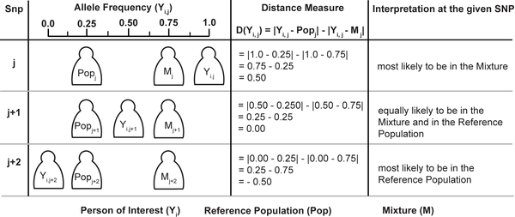
Homer’s attack in a nutshell
The attacker knows:
The genome of the victim (her set of variants)
The size of the mixture he’s attacking
Population allele frequencies
Figure taken from: Homer N, Szelinger S, Redman M, Duggan D, Tembe W, et al. (2008) Resolving Individuals Contributing Trace Amounts of DNA to Highly Complex Mixtures Using High-Density SNP Genotyping Microarrays. PLoS Genet 4(8): e1000167. doi:10.1371/journal.pgen.1000167

Slide 34
GA4GH Beacon Project
Beacon 1
Response: no
Beacon 2
Response: yes
Researcher
Beacon 3
Response: no
Main features:
Allows researchers to quickly query multiple database to find the sample they need
Encourages cross-borders collaboration among researchers
Only provides minimal responses back in order to mitigate privacy concerns

Slide 35
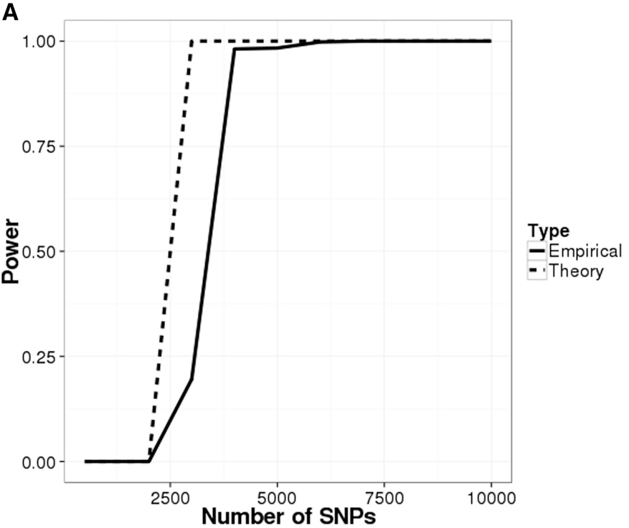

Beacon used as an oracle: the SB attack
Is the target in the beacon ?
Query₁, Query₂, Query₃, …
Response: yes, no, yes, …
Attacker
beacon
Shringarpure SS, Bustamante CD. Privacy risks from genomic data-sharing beacons. The American Journal of Human Genetics. 2015 Nov 5;97(5):631-46.
The attack relies on the assumption that the adversary knows:
The set of variants (VCF file) of the target individual
The size of the beacon
The attack is based on a likelihood ratio test where the adversary repeatedly queries the beacon in order to re-identify the individual
The attack can be extremely dangerous if the beacon is associated with a sensitive phenotype (e.g., cancer)

Slide 36
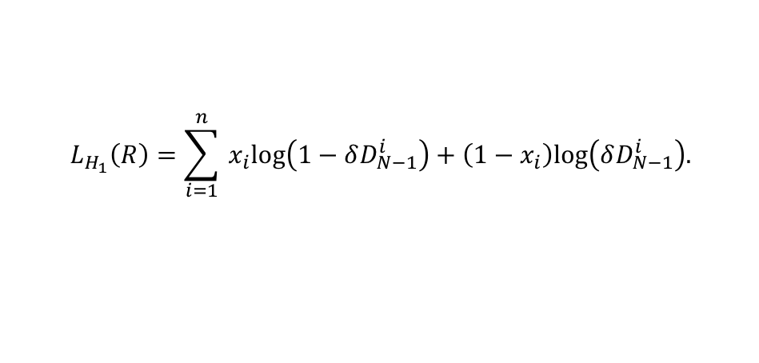
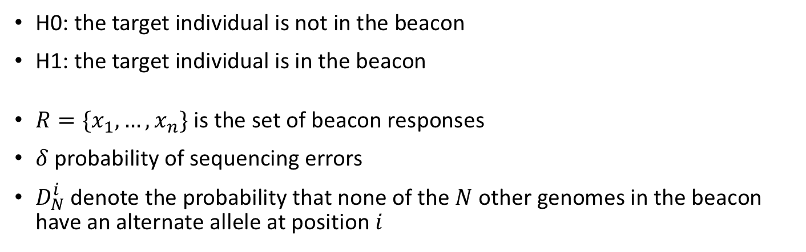
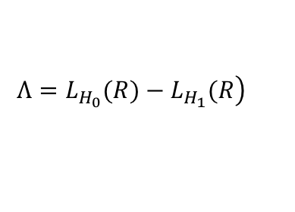
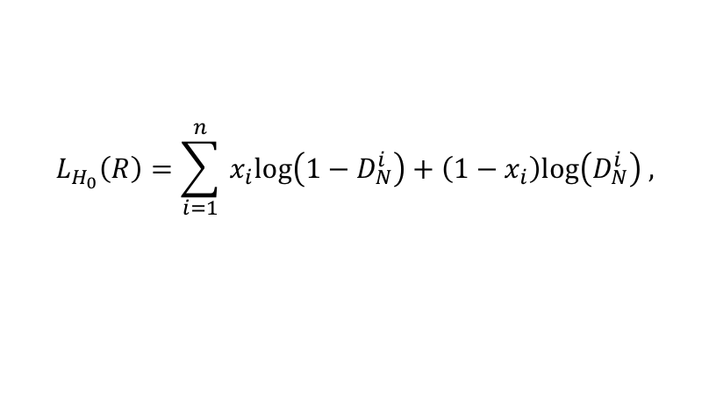
SB Attack: Likelihood Ratio Test
H0: the target individual is not in the beacon
H1: the target individual is in the beacon
$R=\{x_{1},…,x_{n}\}$ is the set of beacon responses
$δ$ probability of sequencing errors
$D_{N}^{i}$ denote the probability that none of the $N$ other genomes in the beacon have an alternate allele at position $i$
$$L_{H_{0}}\left(R\right)=\sum_{i=1}^{n}{‍}x_{i}log\left(1−D_{N}^{i}\right)+\left(1−x_{i}\right)log\left(D_{N}^{i}\right) ,$$
$$L_{H_{1}}\left(R\right)=\sum_{i=1}^{n}{‍}x_{i}log\left(1−δD_{N−1}^{i}\right)+\left(1−x_{i}\right)log\left(δD_{N−1}^{i}\right).$$
$$\left.Λ=L_{H_{0}}(R)−L_{H_{1}}(R\right)$$

Slide 37
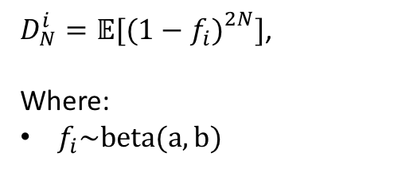
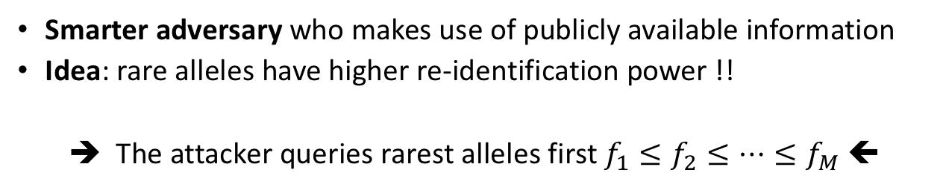
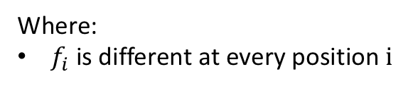
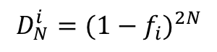
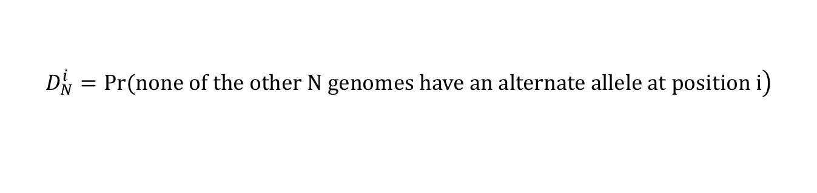
“Optimal” re-identification attack with real allele frequencies
Smarter adversary who makes use of publicly available information
Idea: rare alleles have higher re-identification power !!
➔ The attacker queries rarest alleles first $f_{1}≤f_{2}≤…≤f_{M}$ ⬅
$$\left.D_{N}^{i}=Pr(none of the other N genomes have an alternate allele at position i\right)$$
Original attack [SB15]
“Optimal” attack [R et al. 16]
$D_{N}^{i}=𝔼[{(1−f_{i})}_{}^{2N}]$,
Where:
$f_{i}\sim beta(a,b)$
$$D_{N}^{i}={(1−f_{i})}^{2N}$$
Where:
$f_{i}$ is different at every position i
Raisaro JL, et al. “Addressing Beacon Re-Identification Attacks: Quantification and Mitigation of Privacy Risks”. JAMIA, February 2017

Slide 38
“Optimal” re-identification attack in single population beacon
Experimental setup:
502 EUR samples from 1000 Genomes Project Phase 3 (chromosome 10)
False positive rate of 5%
Notes:
With just 3 SNPs, beacon membership could be re-identified with $100\%$ power and $5\%$ false-positive rate.
Even with the least precise background information (in this case the allele frequencies from EAS ancestry), 36 SNPs are sufficient to re-identify an individual

Slide 39
Kin Genomic Privacy

Slide 40
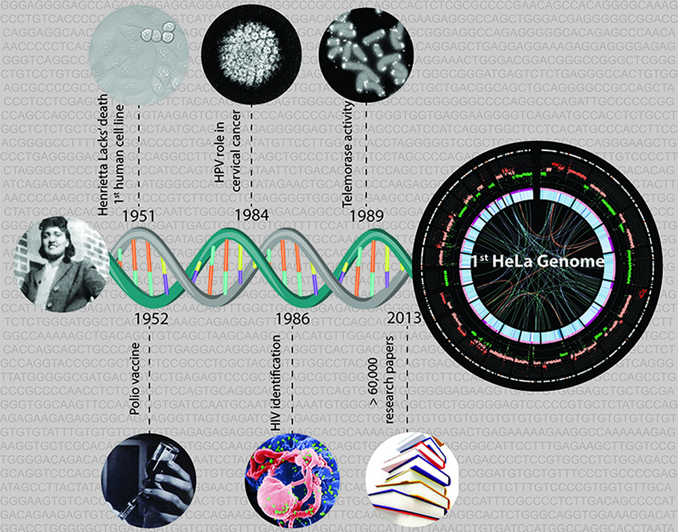
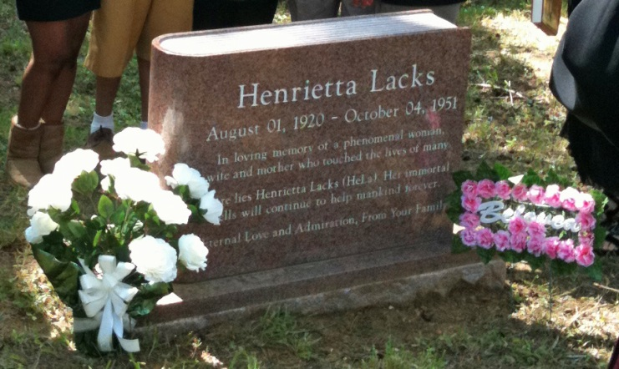
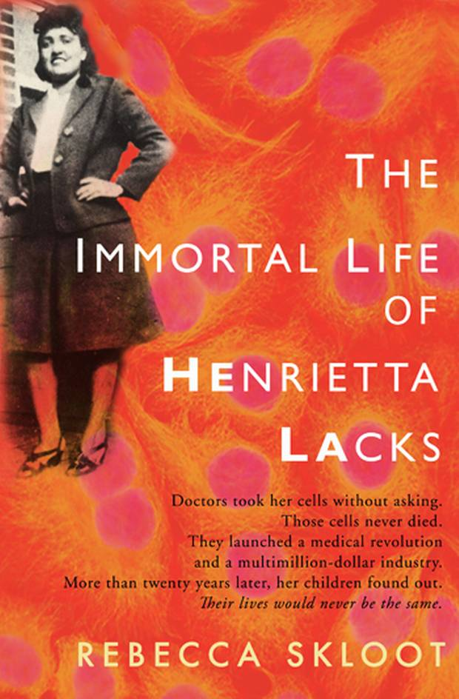
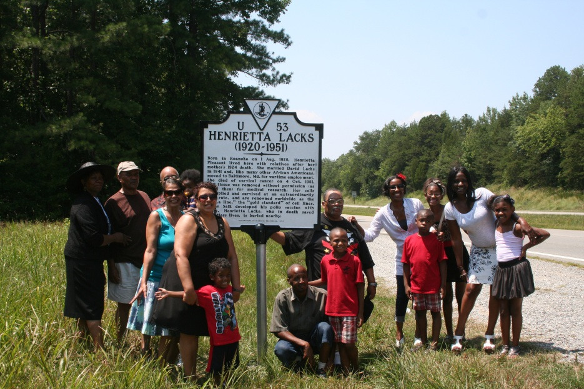
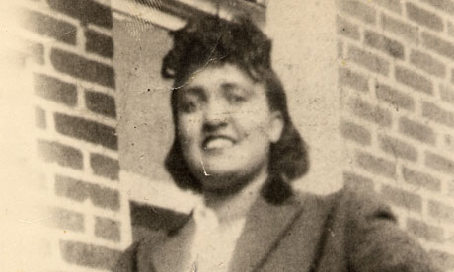
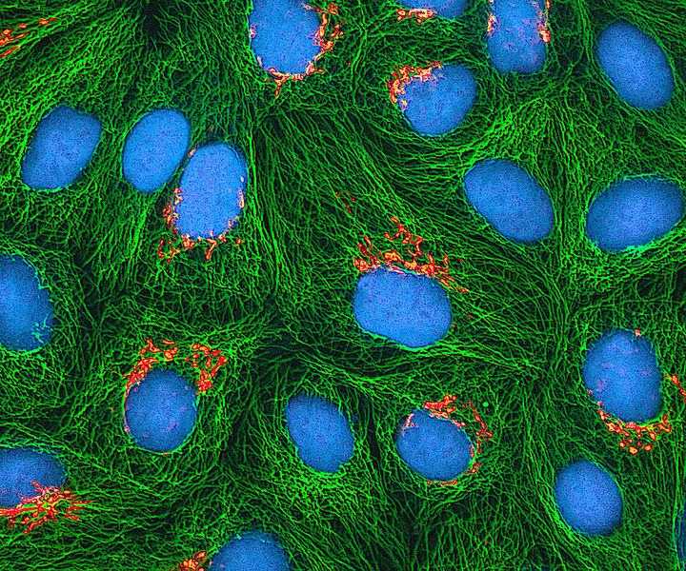
Henrietta Lacks
Image: EMBL/Jonathan Landry
Notes:
Henrietta Lacks was an African-American woman who was the unwitting source of cells (from her cancerous tumor) which were cultured to create the first known human immortal cell line for medical research.

